Slide 1
AirBnB price determination model
Philip Hennes
Robin Schreiber
Leon Wagener

Slide 2
Agenda
Introduction
Our dataset
Data analysis
Price determination model
Limitations

Slide 3

Introduction
Maximizing occupancy rates.
Achieving optimal revenue.
Balancing competitiveness with profitability.
Optimal price determination
New hosts face various challenges
Therefore, Optimal price determination is essential

Slide 4
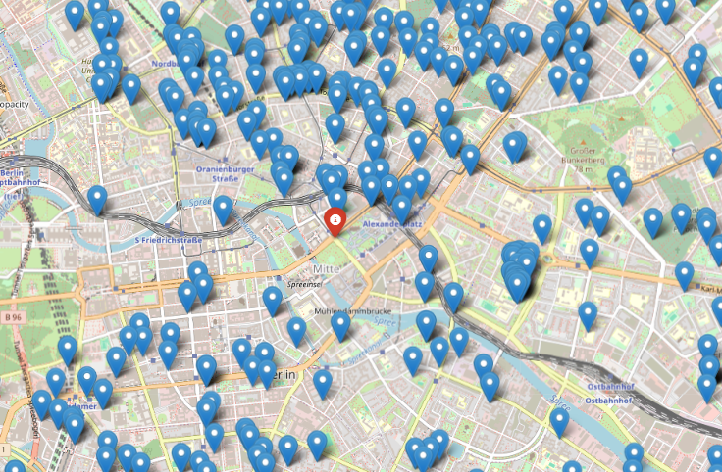
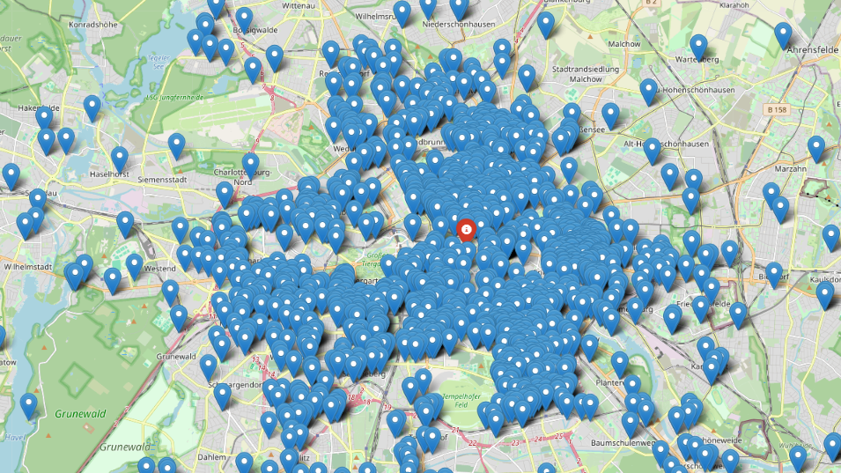

Our dataset
AirBnB listings in Berlin
From Kaggle: https://www.kaggle.com/datasets/thedevastator/berlin-airbnb-ratings-how-hosts-measure-up

Slide 5
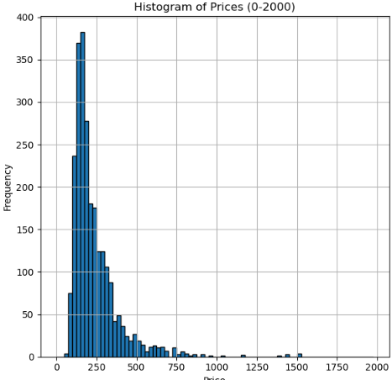
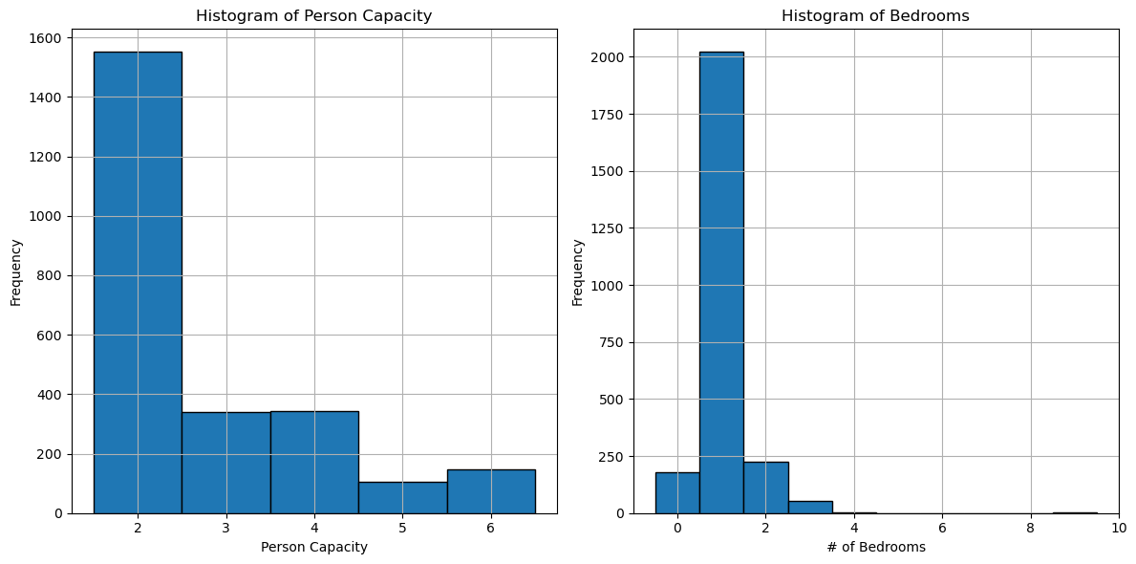
Our dataset
Mean: 244€
Mean: 2.8 persons
Mean: 1.07 Bedrooms

Slide 6
Our dataset
Variables:
realSum | room_type | room_shared | room_private | person_capacity
host_is_superhost | multi | biz | cleanliness_rating | guest_satisfaction_overall
bedrooms | dist | metro_dist | attr_index | attr_index_norm
rest_index | rest_index_norm | lng | lat | Weekday_Weekend
Which variables are relevant for price determination?

Slide 7
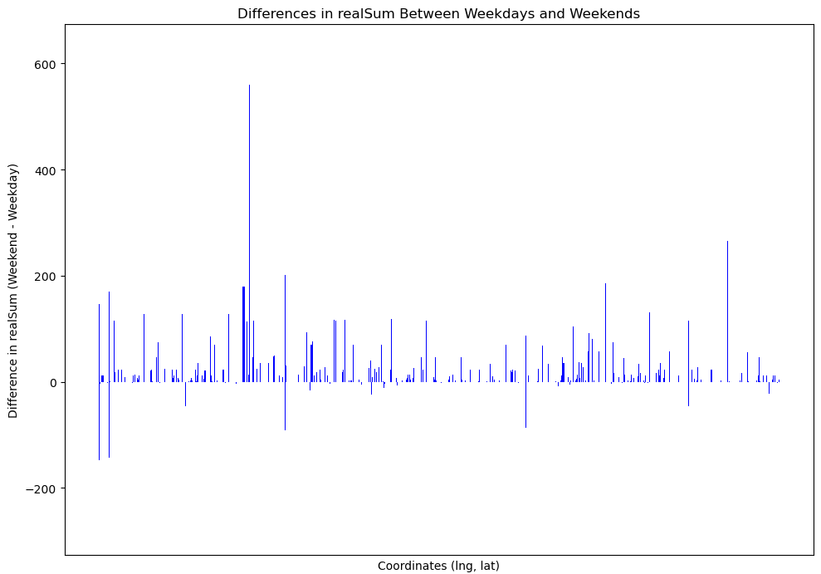
Data analysis – Weekend influence
51% doesn‘t change
36% increase price
Mean: 12€
Mean if increased: 40€

Slide 8
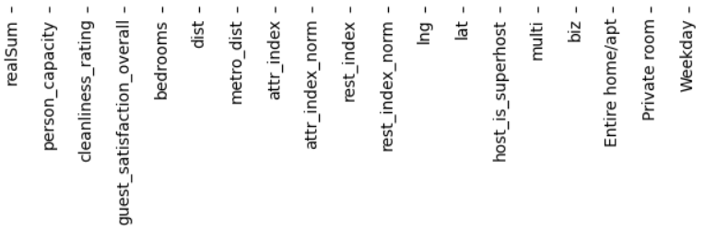
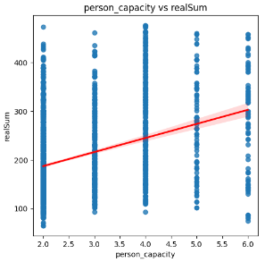
Data analysis – Corrolation

Slide 9
Data analysis – Corrolation
Not accesible data for new hosts

Slide 10
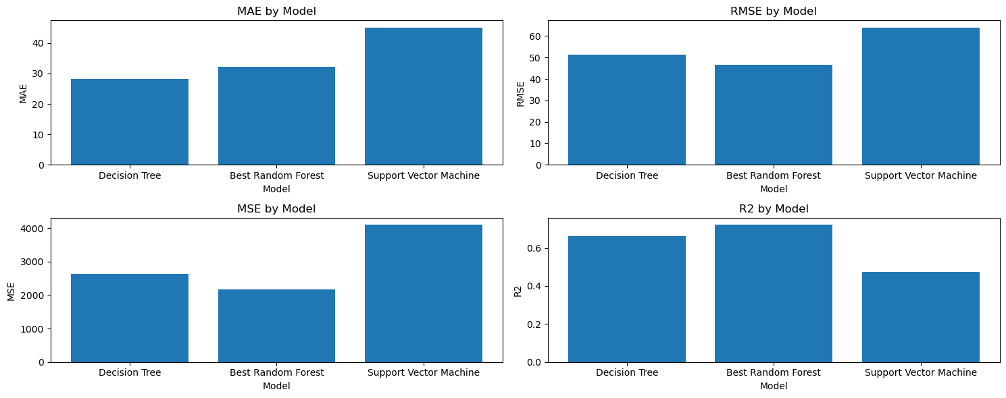
Price determination model

Slide 11
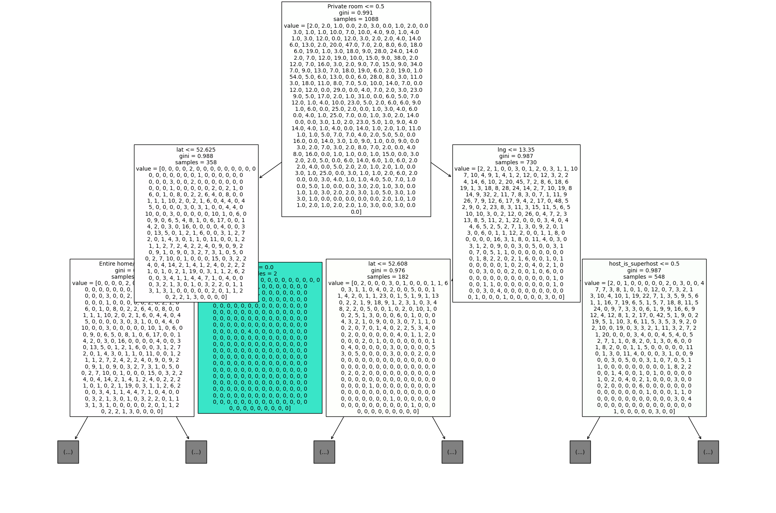
Price determination model – Random Forest
Model parameters:
Trees in Random Forest-
Max tree depths-
Minimum number of samples required to split-
Minimum number of samples required to be at a leaf node-
Best Random Forest:
Trees in Random Forest- 300
Max tree depths- none
Minimum number of samples required to split- 2
Minimum number of samples required to be at a leaf node- 1

Slide 12

Price determination model – Prediction
Capacity: 2
Bedrooms: 2
Distance/Metro distance: 1/ 0.4
Longitude/Latitude: 13.388860/52.517037
Multi/Biz: False/False
Superhost: False
Entire home/apt /Private room: True/False
Weekday: 275€ - 290€
285€
Weekend: 277€ - 310€
291€

Slide 13
Future work and current limitations:
-Seasonal influence
-Development over time
-Transferability to other cities
-Extreme values
-Assumption that existing prices are the optimal prices

Slide 14
Thank you for your attention!

